Slide 1
EAGLE QUIZ APP

Slide 2
1.Christiana Kobiah. 2.Genevieve kankam Mensah. 3.Juliet ama ilupeju. 4.brighsical abenahemaa baidoo. 5.eric nyarko-Sampson jnr.
Group Members

Slide 3
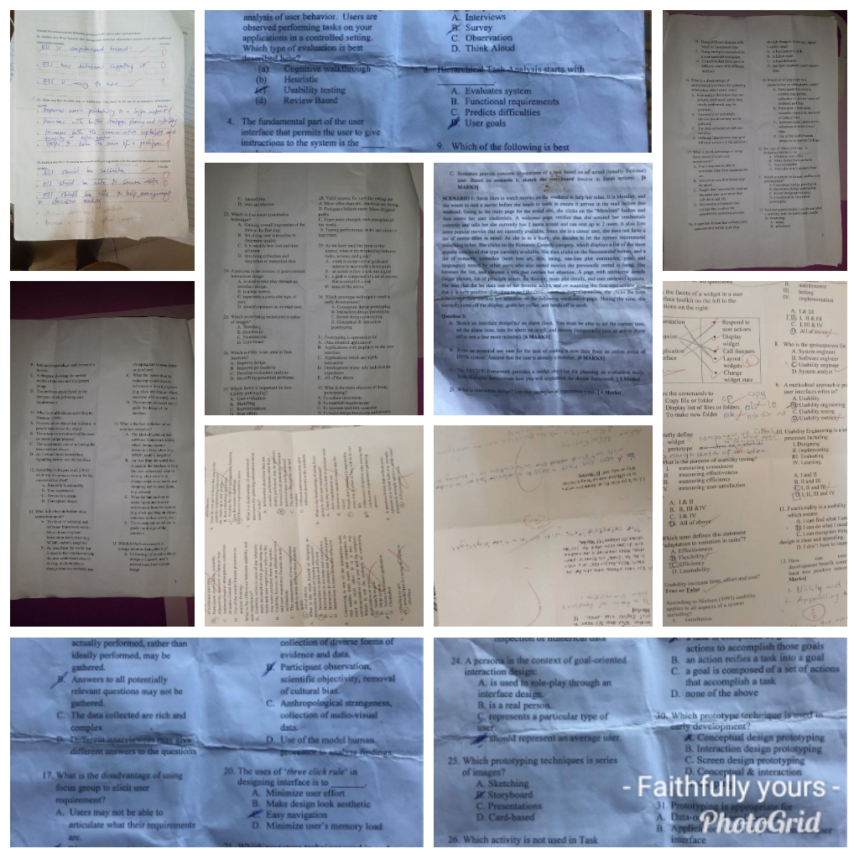
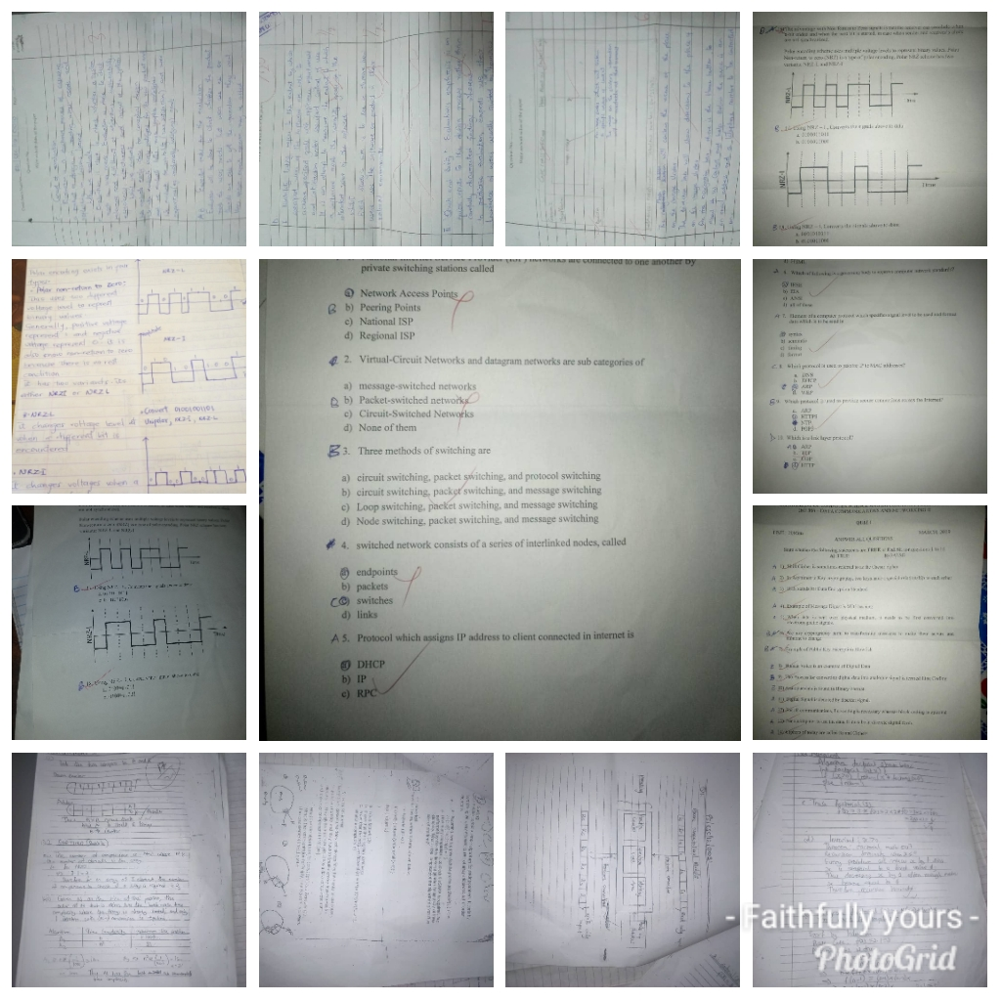
The Life Of Every Student On Campus

Slide 4
Why eagle app?
This app was introduced to:
Reduce the stress students go through.
A good assessment.
Save money.
Have access to most questions they want.

Slide 5
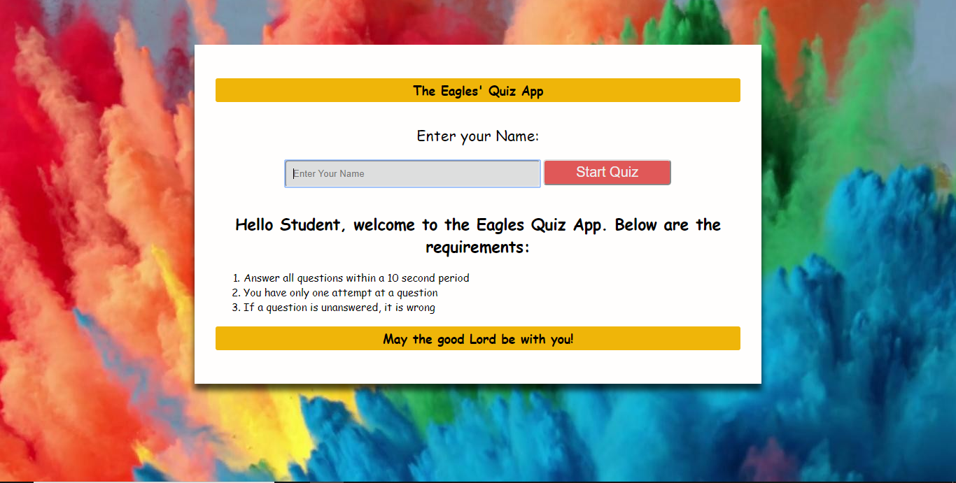
Login page
Login Button
Name Section

Slide 6
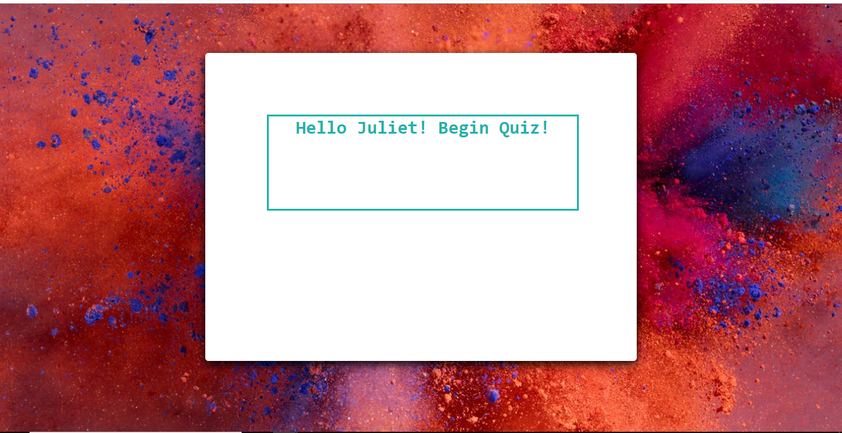
Welcome page

Slide 7
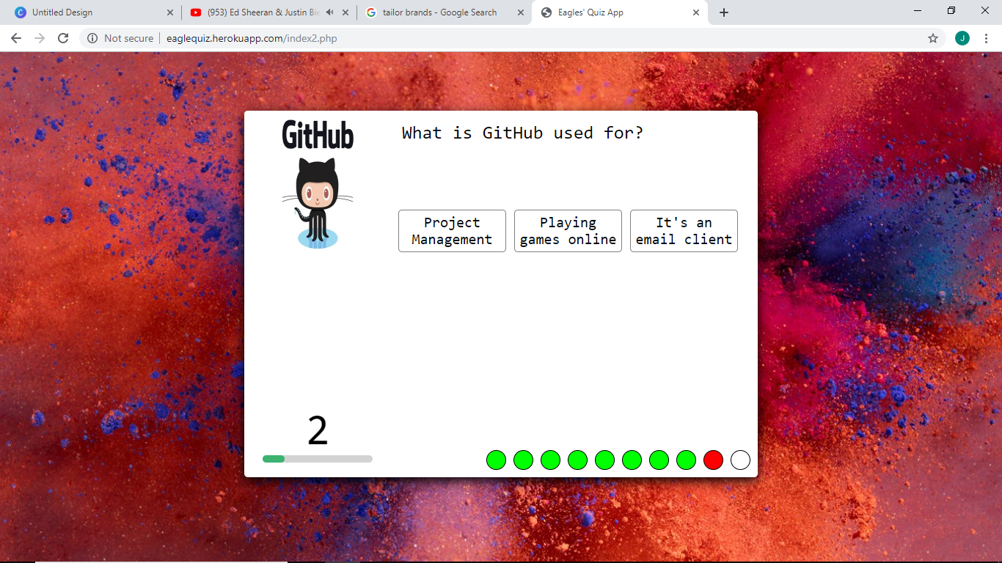
Quiz page
Questions
Image
Timer
Number of questions answered

Slide 8
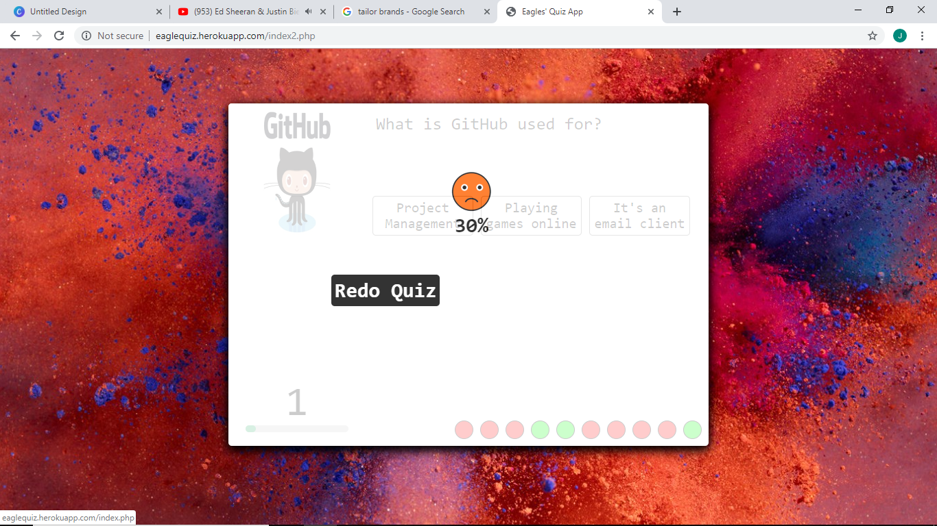
Gives you your score with an emojie
Sends you back to first quiz

Slide 9

Welcome page for second quiz

Slide 10
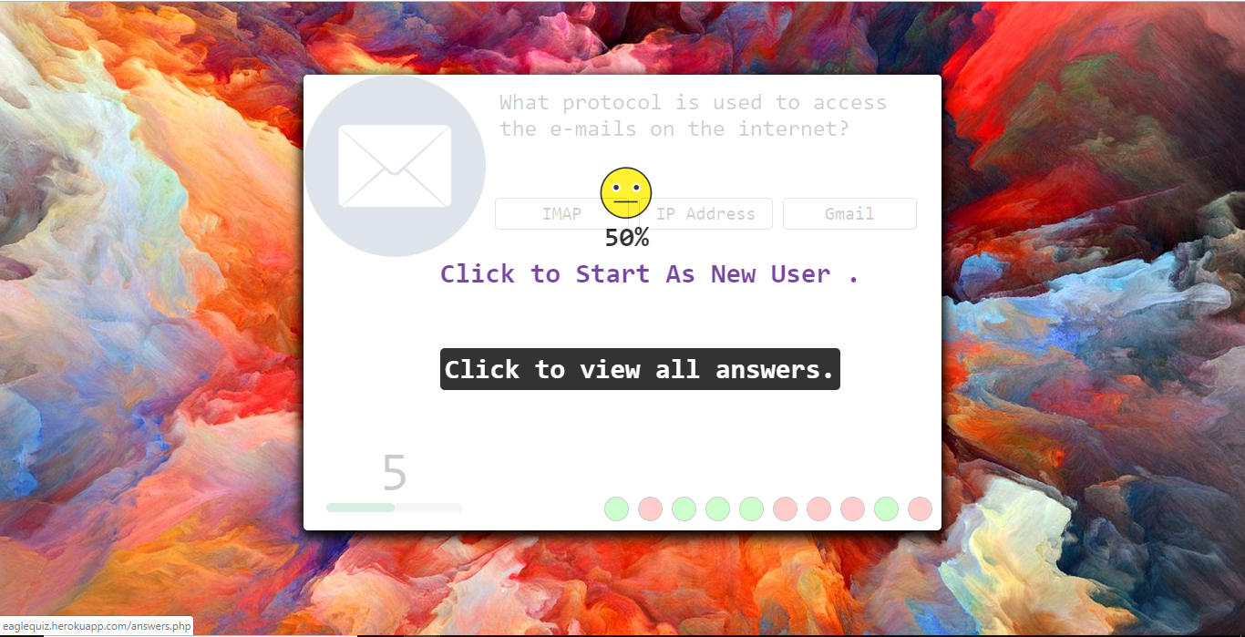
Finish page
Back to first page
Answered questions

Slide 11
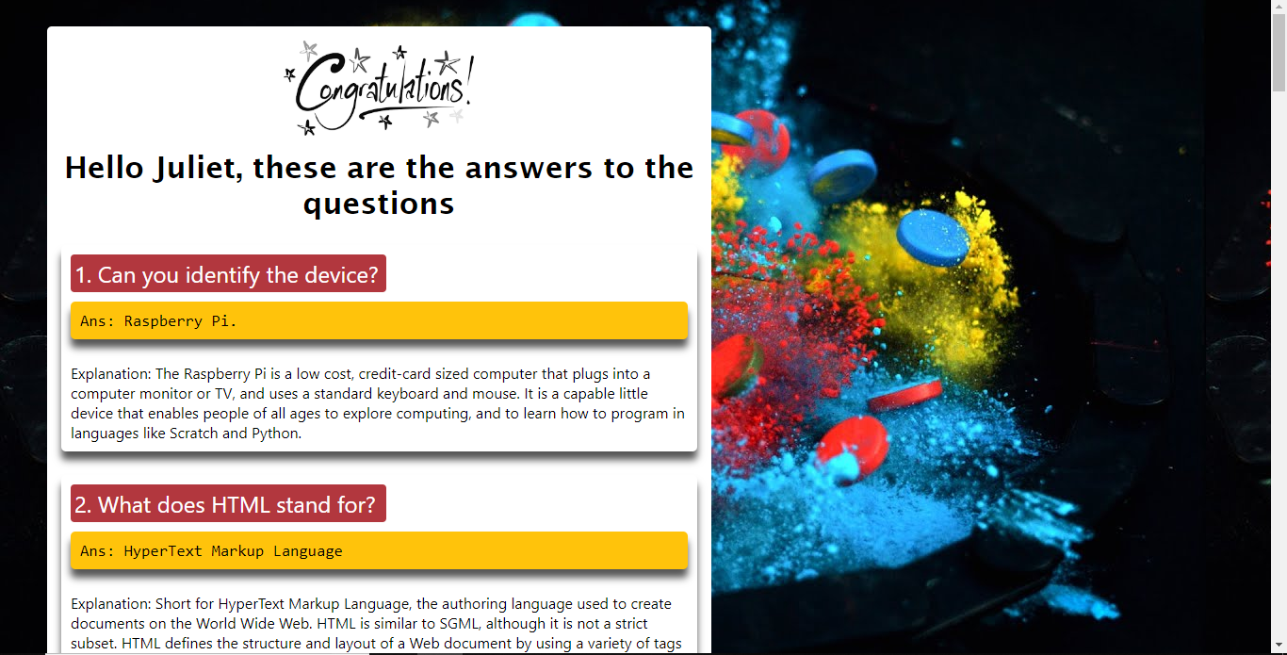
Answer Page
Answered questions

Slide 12
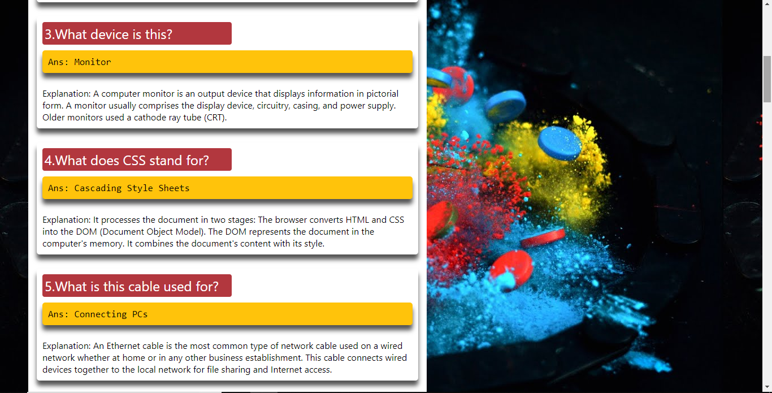
Conti…

Slide 13
Thank you

